Slide 1
User Experience Evaluation Report
Sep-2020

Slide 2
UX Followed Criteria
Area of testing | Description | Evaluation Criteria
User Story | Validate the acceptance criteria of the agreed stories along with completing actions of module purposes | Easiness of use Actions completion Restriction Validation Accessibility & No. of clicks/ steps.
Content & IA | Availability of information & accuracy of the spelling & the correct usage of common language | Accuracy of content Availability of information Availability of core CTAs Availability of support
UI & Typography | Content is legible & readable. Symbol & icons are understandable. Branding & identity is acceptable. | Clarity of icons. Alignment with identity Size of used icons & font
Responsiveness & Gestures | Using the systems from different devises & screen sizes. Ability to zoom, pinch & rotate pages | Accuracy of buttons dimensions Accuracy of screens dimensions Ability to zoom, pinch, rotate. Compatibility with all web browser
Performance | Times to response within clicks | Time consumed per clicks/ loading/ forms
General | Select/ deselect, CTA working, search, URL working & clickable, accessing main menu from any place. | Availability of general features even if not specified in requirements

Slide 3
General
nupco identity isn’t followed (will send you the guideline to be align with corporate communication)
To enable live chat with Contact Center (it can be phase 2 development)
As agreed, we need to test notifications (content & accuracy)
Customer Service number + technical support email should exist in all pages as header
Frequent ask questions (FAQ) should exist in footer
Add Supplier’s journey guide should exist in footer

Slide 4
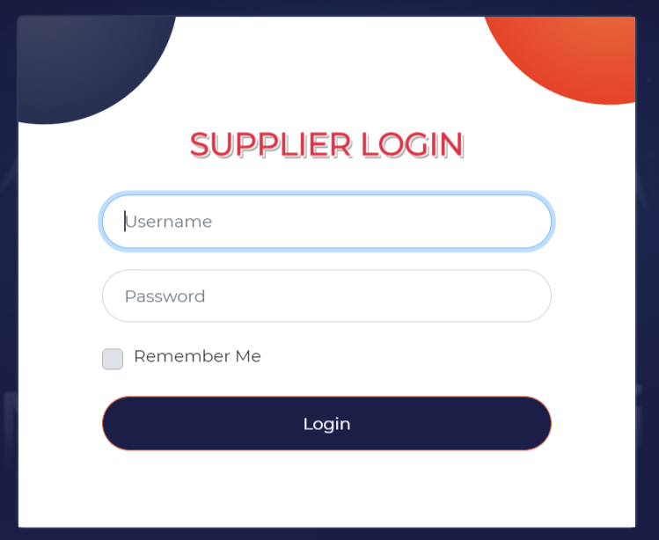
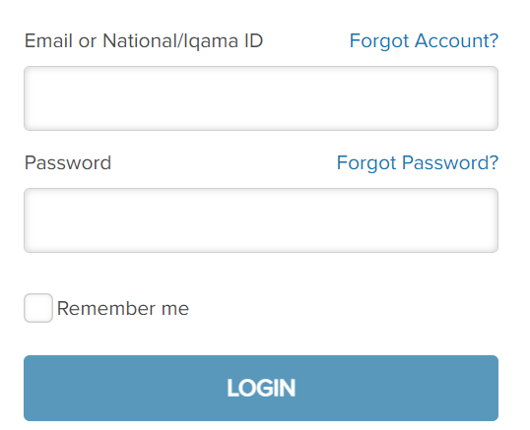
Landing page
Retrieve the password/username* must be automated.
The registration option should be existed.
If the functionalities supported in Arabic, changing the language should be an option in the top of the page pre-login page
Human centric design language is missing.
No option to register. If the business doesn’t want user to register, adding following scenario is needed:
I am a supplier and I want to register Send email to ………
6. How can the user reach this page?

Slide 5
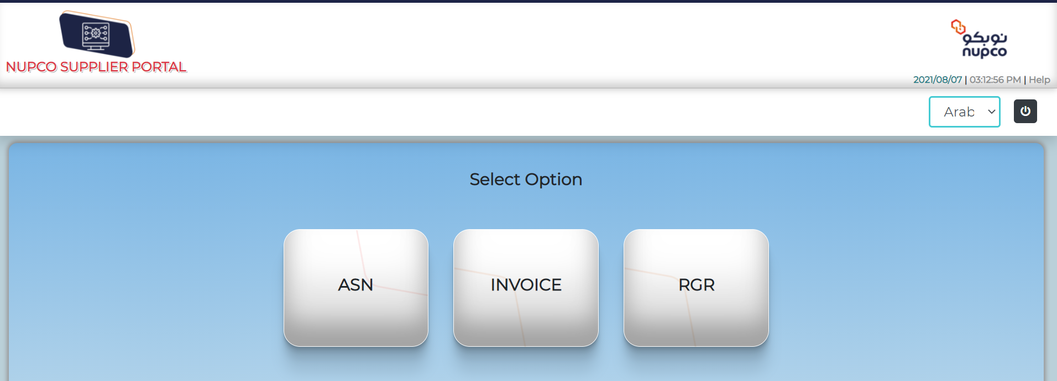



Home Page
The option “Arabic” isn’t working
The language button should be replaced with this icon and make sure that the size of the word English & Arabic is fitted to the window
List the full name of each function, then ended them with abbreviation
The logout icon in the top right means on/ off. It should be replaced with

Slide 6
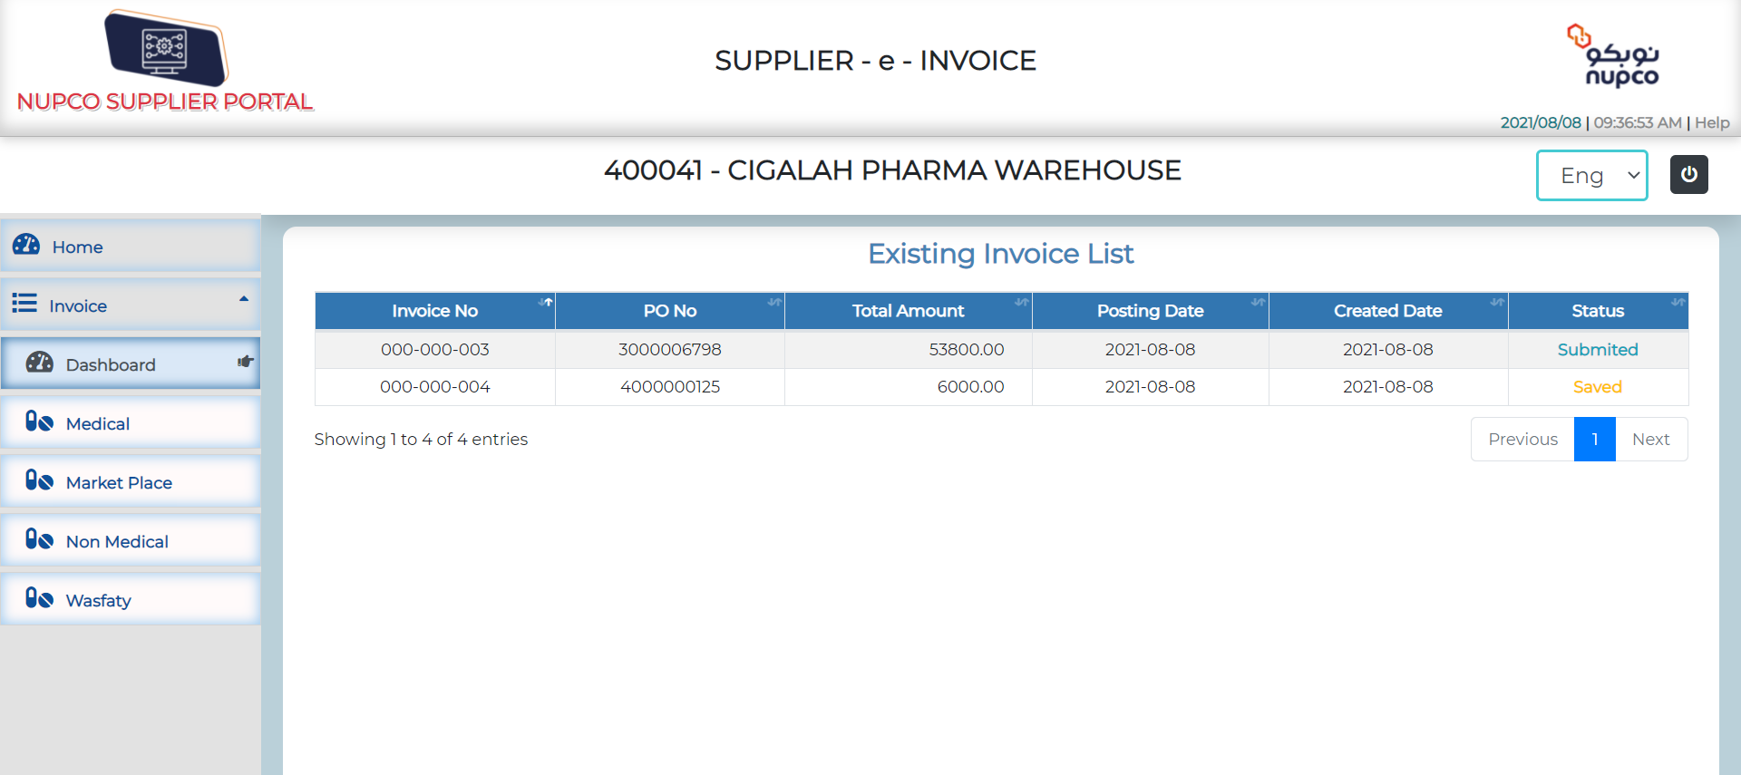

Dashboard
Replace supplier – e – INOIVE to My e- Invoice and locate it in existing invoice list location
Change the options to My Marketplace PO…etc.
Change the icons of all buttons, put MP and Wasfaty logo
Proposed other icons for medical and nonmedical
For Home’s icon please use this instead of this

Slide 7
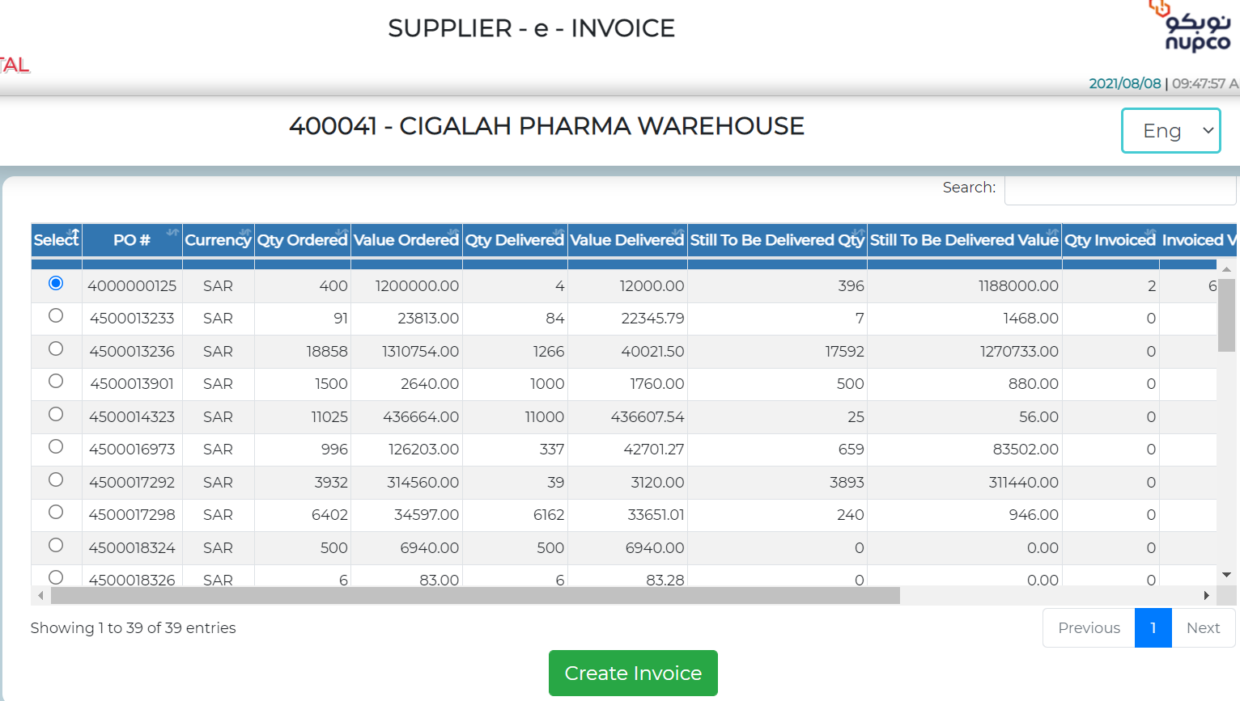
PO List
Change PO # to My PO Number.
Value ordered need to be changed to price
The flow of selecting the row then create invoice need to be changed. Or add description. In order to create invoice please select the needed PO then click on create invoice. (what is the business role )
all amounts needs to have a coma after each 3 digits (ex: 1,000,000.00 instead of 10000000
Search button should be included in the dashboard
Search button should include instruction that indicates only search for PO number

Slide 8
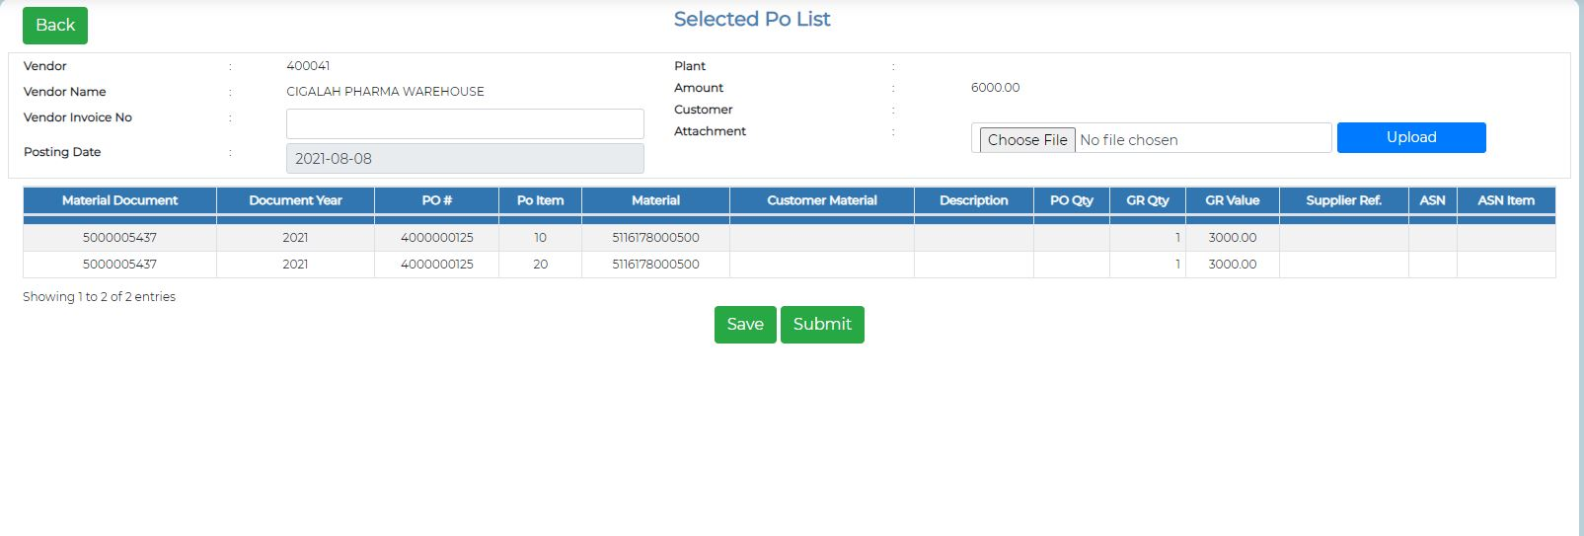
Select Item
Highlight the required fields or add a “*” to the top right of the field
Define what documents or attachments is needed?
What is the difference between save and submit (because save isn’t editable, so it fully same as submit?)

Slide 9
Thank You

